Slide 1
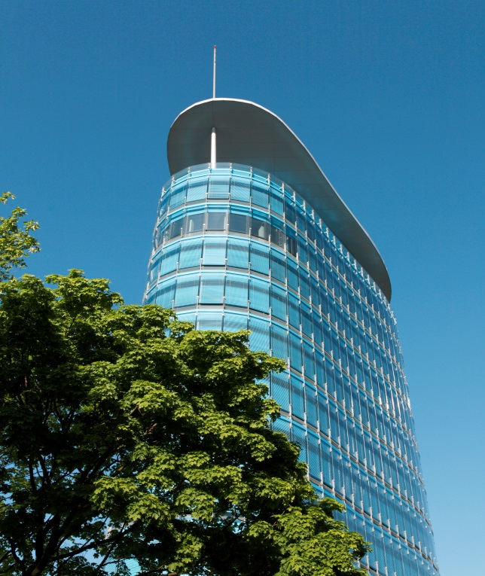


Face Recognition and Voice Recognition Using Autoencoders
Presented By:- Siddarth Venkateswaran (11011753)
12.03.2020
Master | Big Data & Business Analytics
1

Slide 2
Objective
Extract key features from the given input data
Learn their uniqueness by compressing them within a latent space
Perform classification based on this learned latent representation

Slide 3
Datasets Chosen
Labelled Faces in the Wild for face recognition – a dataset of 13233 images of 5749 distinct individuals
Source - http://www.openslr.org/12/
LibriSpeech ASR corpus for voice recognition – A dataset of 1000 hours of speech
Source - http://vis-www.cs.umass.edu/lfw/

Slide 4
Autoencoders
A class of neural networks that compresses and reconstructs a given input data
Commonly used for anomaly detection

Slide 5
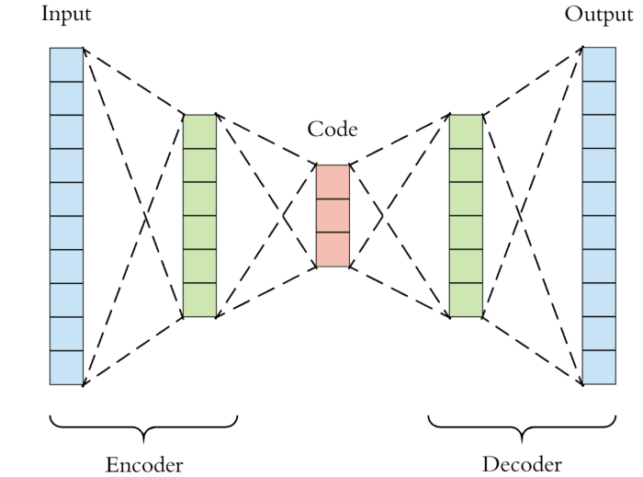
Autoencoders
Image Source - Autoencoders — Guide and Code in TensorFlow 2.0 - Red Buffer - Medium

Slide 6
Autoencoder Techniques Implemented
Convolutional Autoencoder
Deep Autoencoder

Slide 7
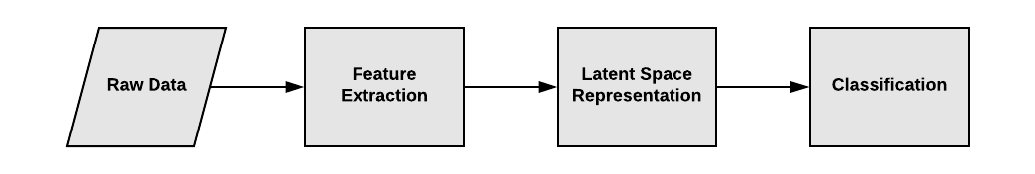
Methodology

Slide 8
Faces Data

Slide 9
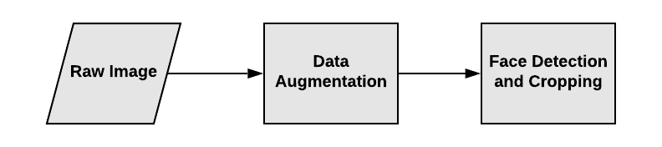
Feature Extraction Process

Slide 10
Data Augmentation
The process of generating a good number of synthetic data from an existing small set of raw data.

Slide 11
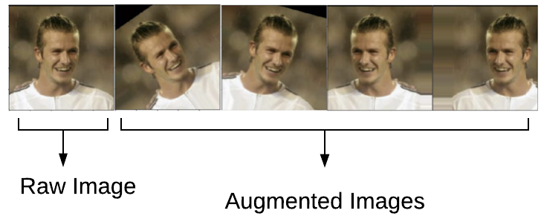
Data Augmentation
Raw Image Credits - http://vis-www.cs.umass.edu/lfw/

Slide 12
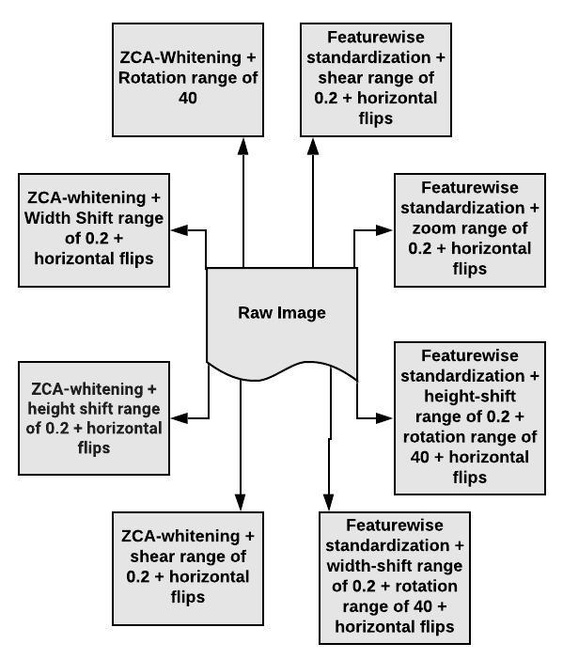
Data Augmentation Techniques

Slide 13
Face Detection and Cropping
This involved drawing bounding boxes on faces detected in the images
This was followed by key-point detection like the eyes, nose and mouth
Faces were cropped from the rest of the images

Slide 14
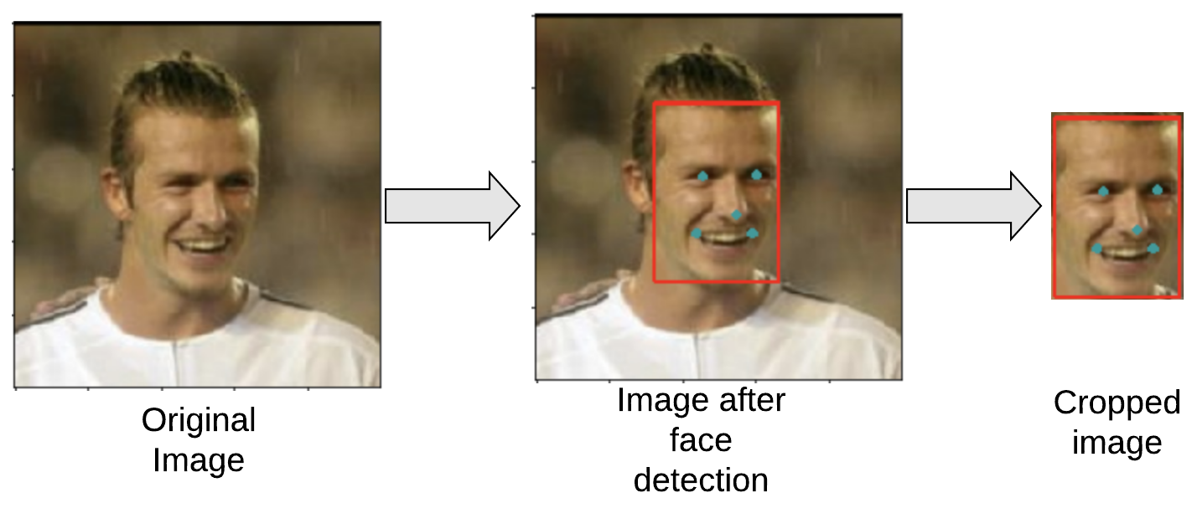
Original Image Credits - http://vis-www.cs.umass.edu/lfw/

Slide 15
Challenges Faced
Images detected with multiple faces in it
Only the relevant faces tagged to the label of the dataset were retained

Slide 16
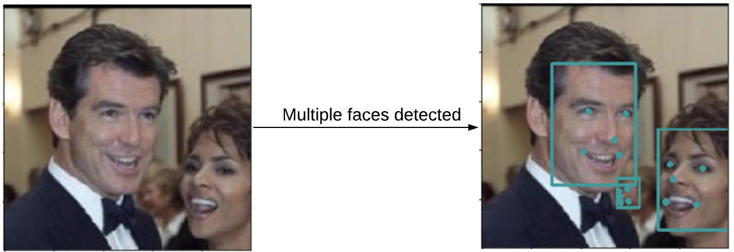
Image Credits - http://vis-www.cs.umass.edu/lfw/

Slide 17
Voice Data

Slide 18
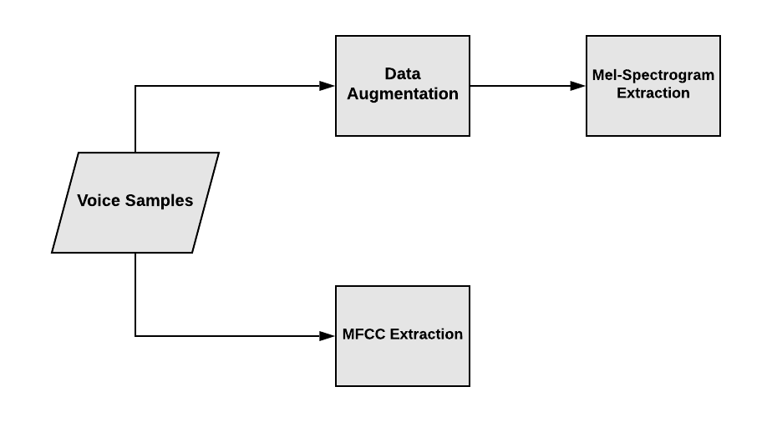
Feature Extraction
*MFCC – Mel Frequency Cepstral Coefficients

Slide 19
Data Augmentation
Audio time series and sampling rates were extracted from each audio file
Each audio file was chunked into 1 second bits
Mel Spectrograms were extracted for each of those bits

Slide 20
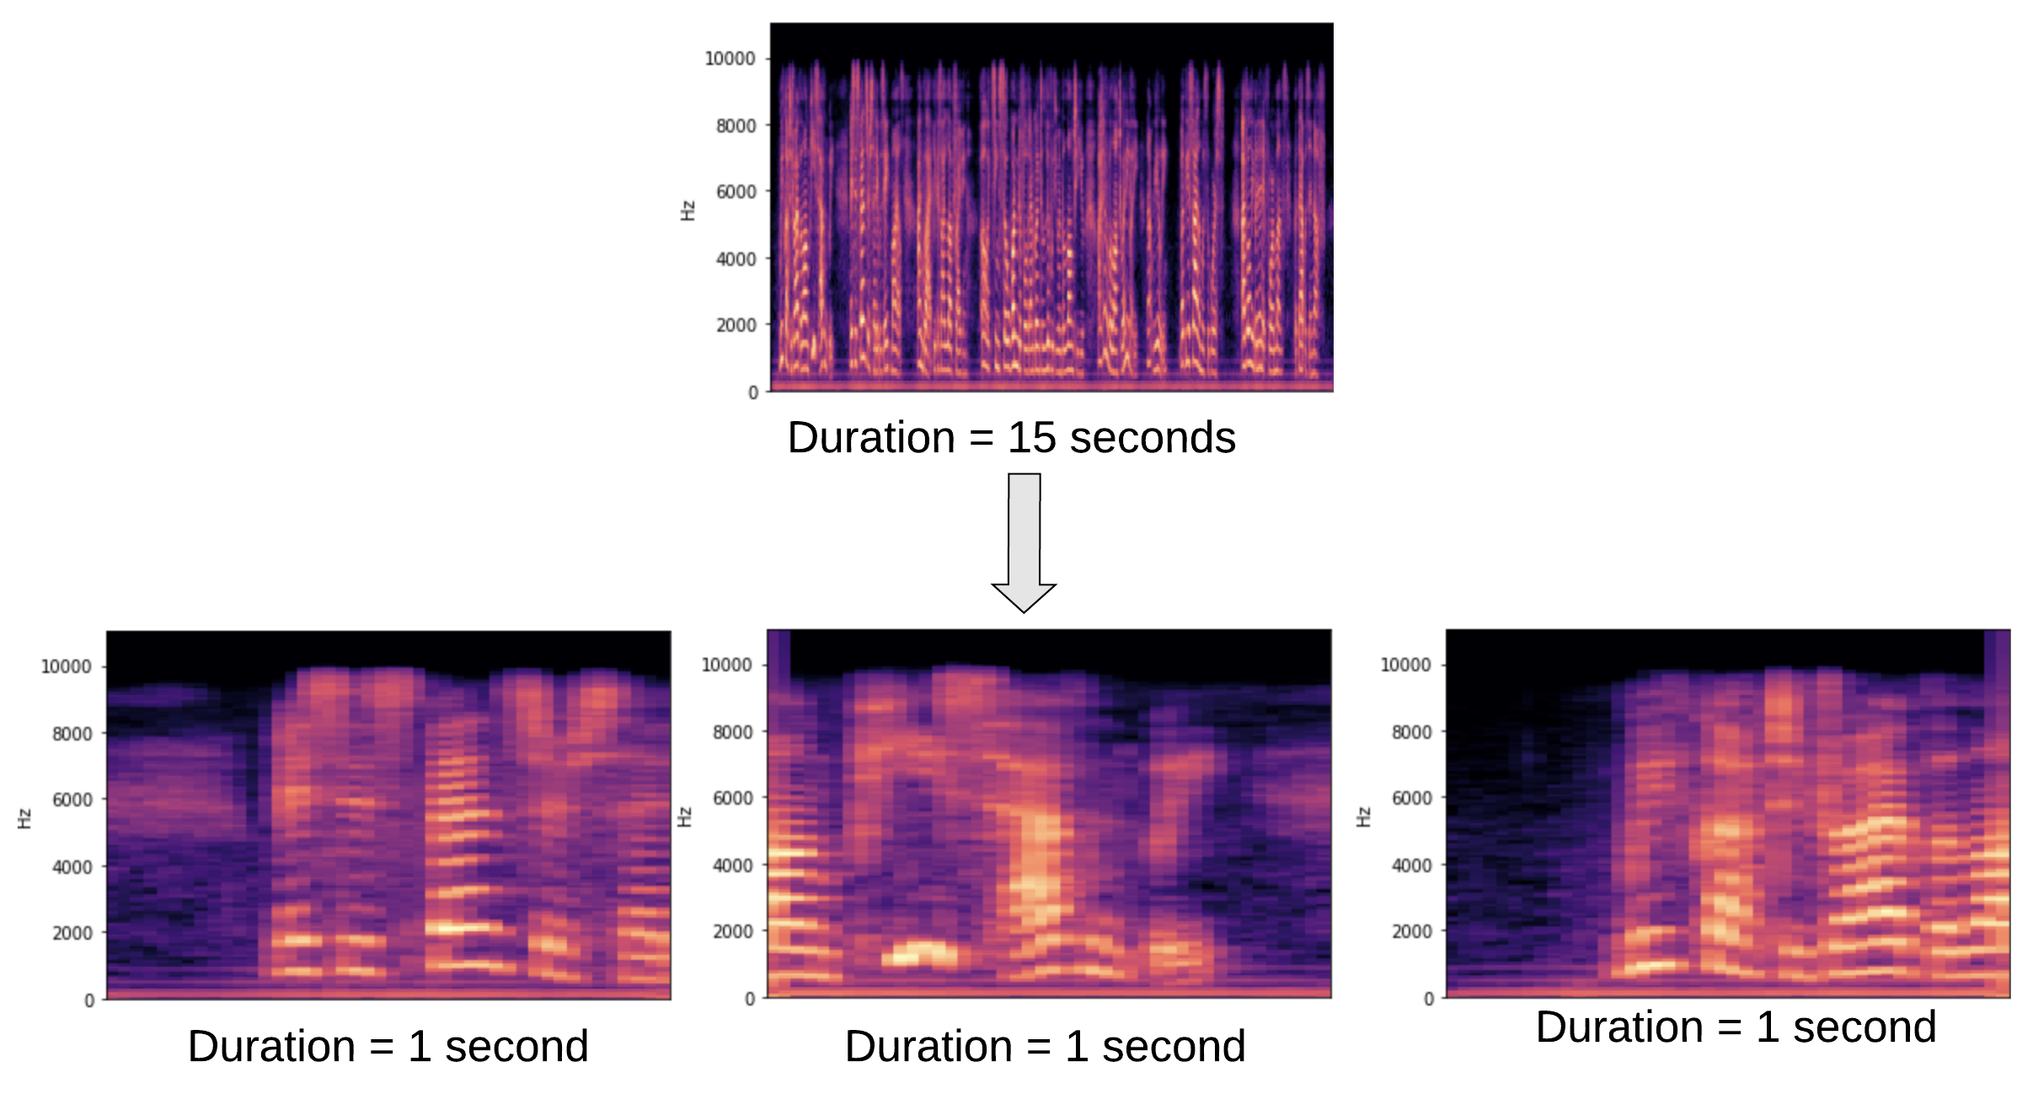
Data Augmentation

Slide 21
MFCC Extraction
40 MFCCs were extracted per audio sample
These were extracted using Python Librosa package

Slide 22
Final Corpora
40000 single-faced images with 250 images per head for 160 distinct individuals
40000 Mel-Spectrogram images – each representing 1 second audio clippings. Sampled at 250 clippings per head for 160 distinct speakers
10000 MFCC features with 100 features per head for 100 distinct speakers

Slide 23
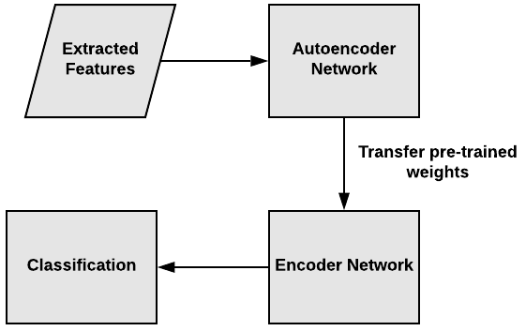
Neural Network Training

Slide 24
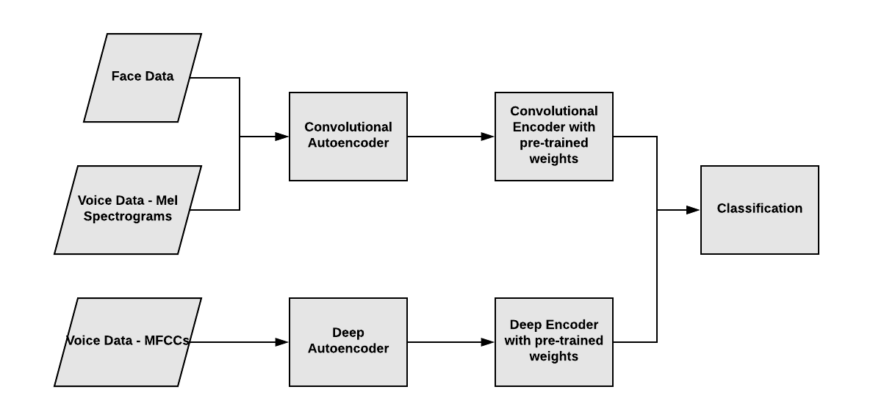
Neural Network Training

Slide 25
Results

Slide 26
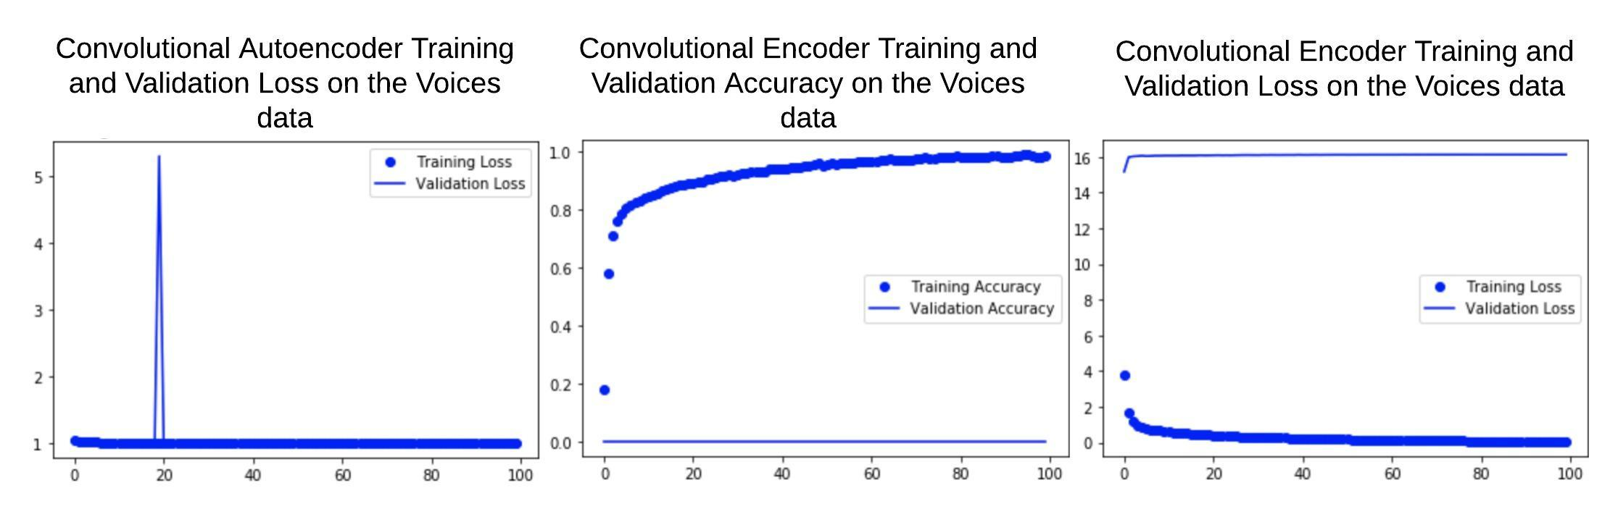
Results

Slide 27
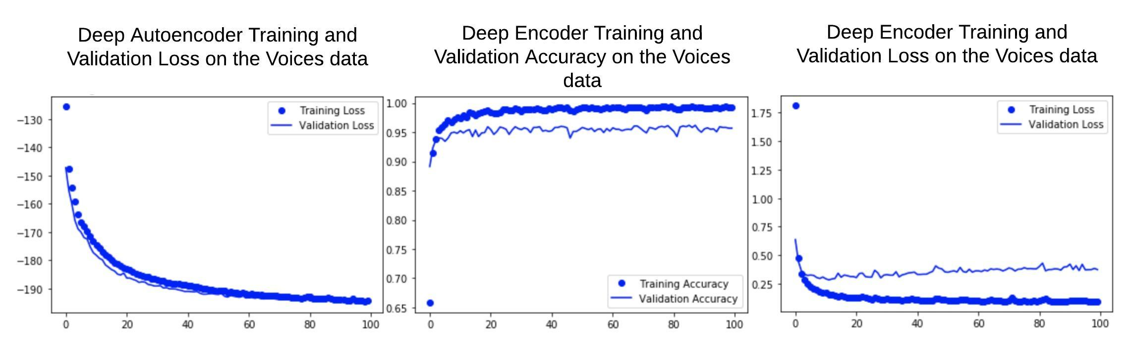
Results

Slide 28
Demo
Demo Face Dataset - Face Recognition Data, University of Essex, UK, Source - https://cswww.essex.ac.uk/mv/allfaces/index.html
Selected 200 images of 10 individuals
Demo Voice Dataset - Free Spoken Digit Dataset (FSDD), Source - https://github.com/Jakobovski/free-spoken-digit-dataset
Selected 100 recordings of 4 speakers

Slide 29
References
https://towardsdatascience.com/a-data-lakes-worth-of-audio-datasets-b45b88cd4ad
http://vis-www.cs.umass.edu/lfw/
https://www.datacamp.com/community/tutorials/autoencoder-classifier-python
https://github.com/jurgenarias/Portfolio/tree/master/Voice%20Classification https://www.cs.cmu.edu/~efros/courses/LBMV07/Papers/viola-cvpr-01.pdf
https://www.youtube.com/watch?v=_FatxGN3vAM
http://www.danielpovey.com/files/2015_icassp_librispeech.pdf
http://practicalcryptography.com/miscellaneous/machine-learning/guide-mel-frequency-cepstral-coefficients-mfccs/

